Slide 1
Telco Customer Churn & Service Analysis
Customer, Service & Lifecycle Patterns Associated with Churn

Slide 2
Business Problem & Questions
BUSINESS PROBLEM
A telecommunications company is experiencing customer churn but lacks a clear understanding of the customer, service and lifecycle characteristics associated with customers leaving.
The analysis focuses on three key business questions:
01 – Customer Characteristics
Which customer characteristics are associated with higher churn?
02 – Service Engagement
How is customer service engagement associated with churn?
03 – Customer Lifecycle & Contract
At what stage of the customer lifecycle is churn most concentrated, and how does contract type relate to this pattern?

Slide 3
Data & Analytical Approach
SOURCE DATA
Datasets | Rows | Columns | Purpose
Demographics | 7,043 | 9 | Customer demographic characteristics
Services | 7,043 | 31 | Service usage, tenure, contracts and billing information
Status | 7,043 | 12 | Customer status and churn information
Location | 7,043 | 10 | Customer geographic information
Population | 1,671 | 3 | Geographic population information
ANALYTICAL WORKFLOW
Source Datasets → Data Exploration → Data Cleaning & Validation → Cleaned Customer-Level Dataset → PostgreSQL → Derived Analytical Fields → SQL Business Analysis → Power BI Dashboard → Findings & Recommendations
5 datasets | 7,043 customers

Slide 4
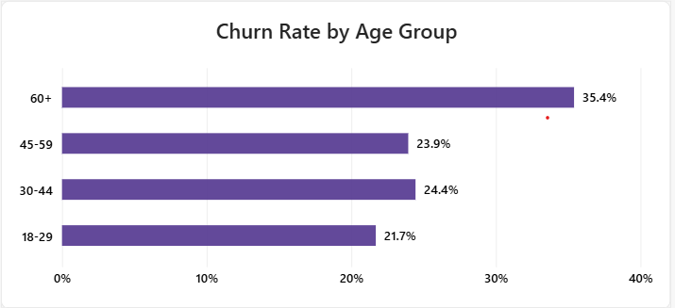
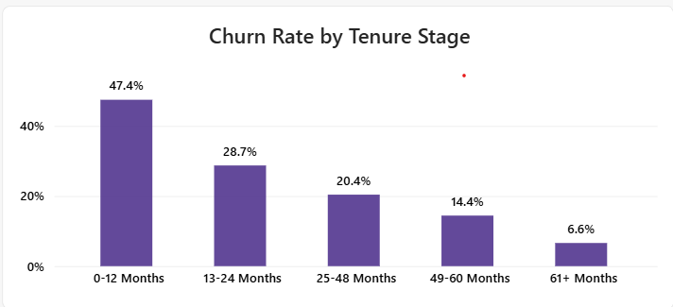
Key Findings – Customer & Lifecycle Patterns
60+ → 35.4%
Highest observed churn
Churn varies across age groups
0–12 months → 47.4%
Highest observed churn
Churn declines as tenure increases in the dataset

Slide 5
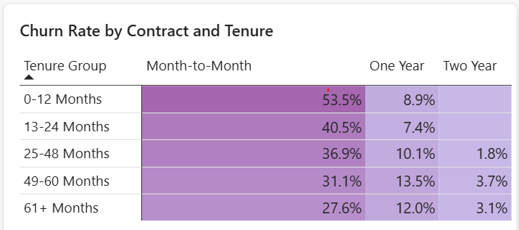
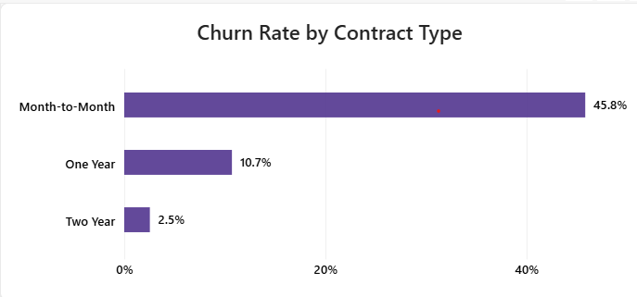
Key Findings – Contract & Lifecycle
Month-to-month customers had the highest observed churn across every tenure stage, reaching 53.5% in the first 12 months.

Slide 6
Business Recommendations
1. Prioritize further investigation of early-tenure customers, particularly during the first 12 months, through stronger onboarding and engagement.
2. Investigate month-to-month customers, as this segment shows substantially higher observed churn across tenure stages.
3. Investigate high-churn service segments, particularly Fiber Optic customers, to understand potential service or experience-related factors.
4. Use customer segmentation based on age, household status, referrals, services, tenure and contract type to identify groups requiring further investigation.

Slide 7
Limitations
The dataset does not explain why customers churn beyond the available customer and service attributes.
Some service-related fields contain expected missing values.
The analysis does not measure the financial impact or cost of retention actions.

Slide 8
Thank You

